Slide 1
Krav & UML
I dag:
Lidt om Kravspecifikationer
Start på UML
Domæne Model
Use Cases
Start på Mario-opgave

Slide 2
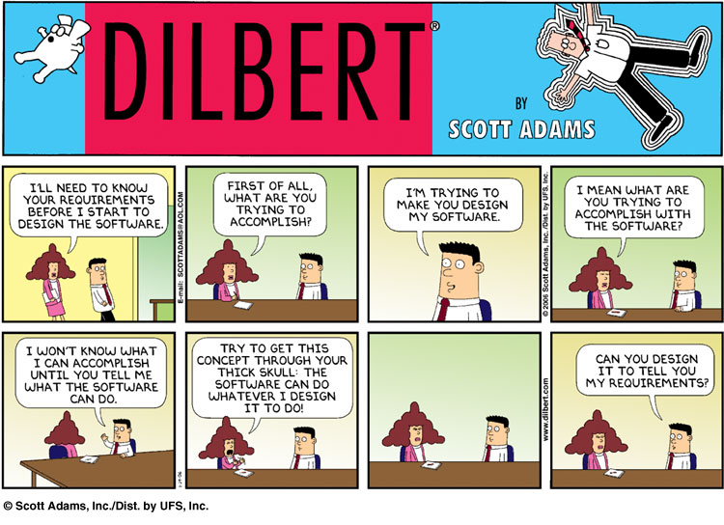

Slide 3
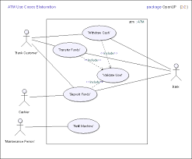
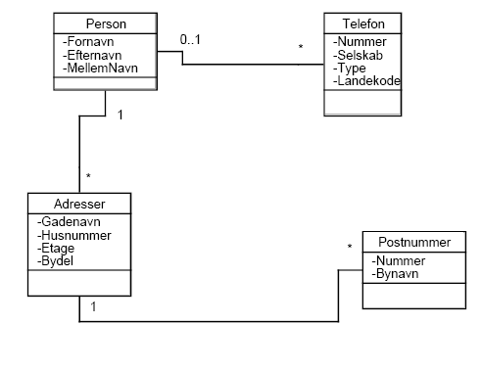
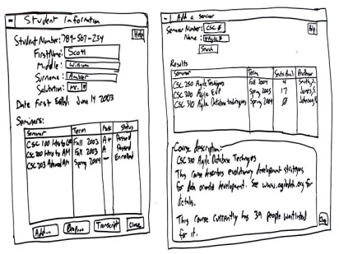
IT-systems lifecycle/development
IDEA
Decision and
contract
Production
operation
time
Vision
and Goal
Functional Req.
Domain model
Mock Ups
Requirements specifikation

Slide 4

Krav, kunder og brugere - hvad er problemet?
Vi skal levere et IT-system, men hvad vil kunden have?
Ved kunden det selv?
Formål/mål
Funktionalitet
Input/output
Kan kunden forklare os det?
Fælles Sprog
Kan vi hjælpe kunden?
Viden om IT
Kan vi forstå og fastholde/dokumentere kravene?
Kravspecifikation
Kan krav ændre sig i udviklingsperioden?

Slide 5
System development
Requirements specifikation
IDEA
Decision and
contract
Production
TEST
time
What are we supposed to accomplice?
Understand customers intensions
Understand customers domain
Identify customers requirements
Formulate requirements
Listen to the customer
Help the customer to understand the possibilities
Document requirements
Verify requirements
Be ready to start developing the system
Tools:
Vision & Goals
Domain model
Use Case diagram
User Stories
Mock Ups

Slide 6
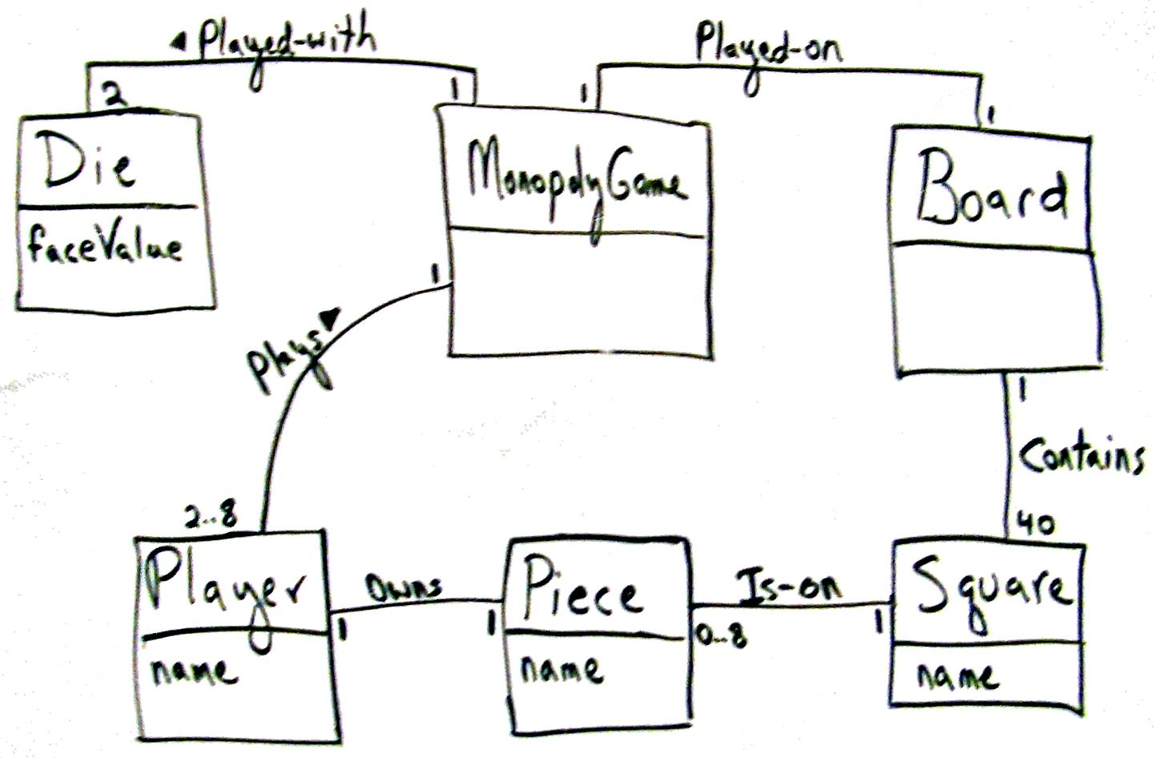
Domain model with UML
Before starting analyzing requirements it might be a good idea to try to understand the domain, and its concepts!

Slide 7
What is a Domain Model?
Illustrates meaningful conceptual classes in problem domain
Represents real-world concepts, not software components
Software-oriented class diagrams will be developed later, during design

Slide 8
A Domain Model is Conceptual, not a Software Artifact
Software Artifacts:
Conceptual Class:
SalesDatabase
Sale
amount item
vs.
Sale
Double amount; Item item;
void print()

Slide 9
Steps to create a Domain Model
Step by step:
Identify candidate conceptual classes
Draw them in a UML domain model
Add associations necessary to record the relationships that must be retained
Add attributes necessary for information to be preserved
Use existing names for things, the vocabulary of the domain
The key to identify classes: NOUN PHRASES

Slide 10
Example domain model
Object
Player
Die
name
faceValue
Attribut
DiceGame
Association

Slide 11
Let’s try!
This school has many students, distributed into classes, each student goes in one class. Each class has many hours in various subjects, and these subjects are held in many different rooms. This school has several teachers who teach more classes ………

Slide 12
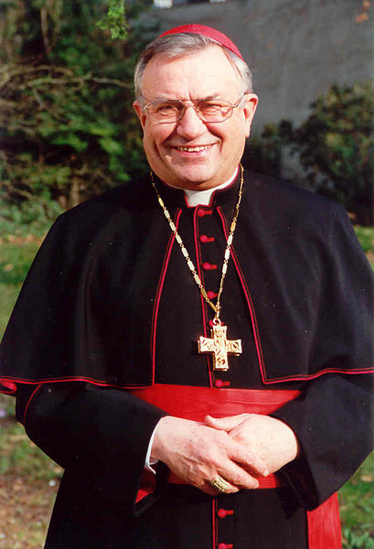
Kardinalitet/multiplicity
Kardinalitet/multiplicity siger noget om, associationen mellem 2 domæneklasser
1-til-1
1-til-mange
Mange-til-mange
En kardinal…

Slide 13
Kardinaliteter/multiplicity
1-til-1, aka 1:1 | Et objekt fra den ene domæneklasse, kan kun relateres til et objekt fra den anden domæneklasse f.eks. Elev-har-CPRnumnmer
1-til-mange, aka 1:* | Et objekt fra den ene domæneklasse, kan relateres til flere objekter fra den anden domæneklasse, men ikke omvendt! f.eks. Elev-Går i-Klasse
mange-til-mange, aka *:* | Flere objekter fra den ene domæneklasse, kan relateres til flere objekter fra den anden domæneklasse f.eks. Lærer-Underviser i-Fag

Slide 14
Monopoly Game Domain Model

Slide 15
Multiplicitet
Ud fra beskrivelsen – og vores egen viden – kan vi nu tilføje multiplicitet til vores relationer
Elev
*
1
Klasse
Fag
*
*
Lokale

Slide 16
Let’s try!
This school has many students, distributed into classes, each student goes in one class. Each class has many hours in various subjects, and these subjects are held in many different rooms. This school has several teachers who teach more classes ………

Slide 17
Øvelse 1
Find Mario-opgaven på Sharepoint og lav første udkast til en domænemodel!

Slide 18
Introduction to Use Cases
Use Case: “... a typical interaction between a user and a computer system”, Booch
Here, “user” is anything that needs or invokes the functionality of the system
“Computer system” is the system being modeled
Use cases capture and document the user-visible functionality of a system (functional requirements)
Use cases capture how the system will benefit the user
Each use case represents a discrete goal for the user
Notes:
Examples of modeling languages:
Data Flow Diagrams
Entity Relationship Diagrams
Flow Charts
Context Diagrams
State Charts
Object-oriented Systems Modeling (OSM)
The term model is actual a more appropriate term for what Booch, et al.m informal refer to as a modeling language.

Slide 19
Use case diagrams
A use case diagram is UML’s notation for showing the relationships among a set of use cases and actors
A use case diagram can help the software engineer to convey a high-level picture of the functionality of the system

Slide 20
Use Case Focused Product Requirements
Use Case Diagram: Functional Requirements Describing System from User Perspective
Photo Sharing Site
upload
member
organize
view
friend
administrator

Slide 21
Create Use Cases: Walk Through
Identify actors
Define use cases
Discover reuseable use cases
Photo Sharing Site
upload
member
organize
view
friend
administrator
Notes:
Reference: http://gatherspace.com/static/use_case_example.html#1

Slide 22
System development with Use Cases
Identify actors
Define use cases
Discover reuseable use cases
Write use case description for each use case
brief description
casual
Fully dressed
Notes:
Reference: http://gatherspace.com/static/use_case_example.html#1

Slide 23
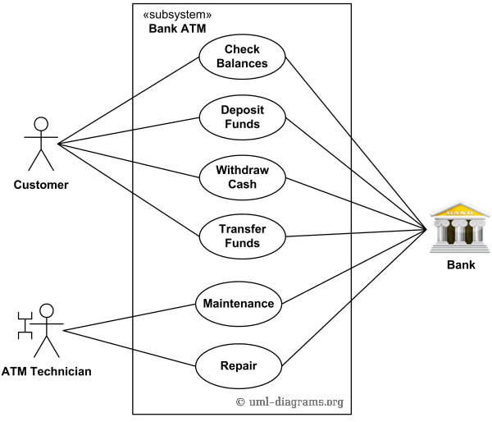
use case diagram
System border

Slide 24
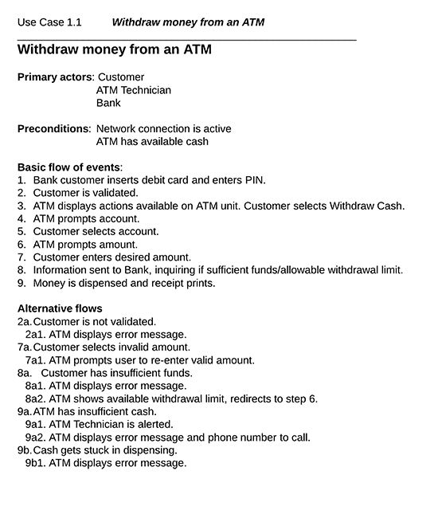
Work with use cases!

Slide 25
USE CASE – hvor stor skal den være?
ER DET SVÆRT AT BESKRIVE ”MAIN SUCCES SCENARIO”?
OMFATTER DEN MANGE SKÆRMBILLEDER (Mock Ups)
KAN MAN DELE DEN I 2 ELLER FLERE MINDRE USE CASES?

Slide 26
USE CASES – hvordan vælger vi?
VIGTIGST FOR FORRETNINGEN (KUNDEN)
KOMPLEKSITET (SYSTEMET)
RISIKO (PROJEKTET)

Slide 27
Vigtighed for Kunden og kompleksitet!
Customer Priority
Identify whether functionality is highest priority and is the focus of the system, or borders on being out-of-scope with a real potential to be postponed.
This gives you a way of seeing what the Importance of the use case to the business, and the urgency to have the functionality available.
Complexity
You need to assess whether functionality contains simplistic input and output algorithms or intricate critical methods. Typical complexity factors to consider are:
Number of Actor Profiles
Number of proposed scenarios

Slide 28
MARIOS PIZZA SP. Opgave #2
Find opgaven på Sharepoint!
Udarbejd en domænemodel
Udarbejd et Use Case Digram
Prioritér Use Cases
Beskriv Main Succes Scenarie (aka basic flow of events) & Alternative Flows for højest prioriterede Use Case
Start med at kode i prioriteret rækkefølge, når I når der til!

